Slide 1
Lecture 5: Machine Learning Fundamentals
ECON 490: Applied ML in Econ

Slide 2
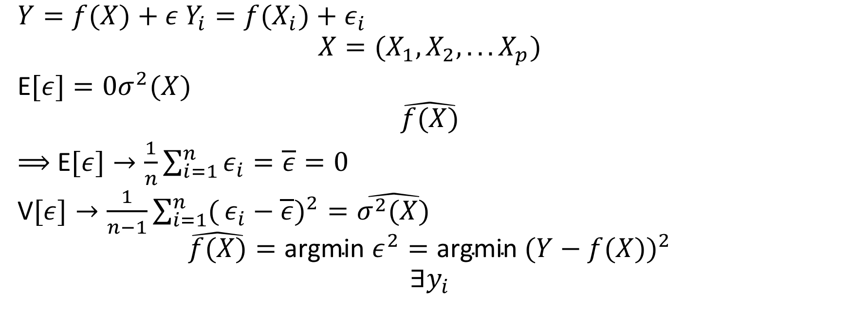
Math
$Y=f(X)+ε$ $Y_{i}=f(X_{i})+ε_{i}$
$$X=(X_{1},X_{2},...X_{p})$$
E$[ε]=0σ^{2}(X)$
$$\hat{f(X)}$$
$⟹$ E$[ε]→\frac{1}{n}\sum_{i=1}^{n}{ε_{i}}=\overline{ε}=0$
V$[ε]→\frac{1}{n−1}\sum_{i=1}^{n}{(}ε_{i}−\overline{ε})^{2}=\hat{σ^{2}(X)}$
$$\hat{f(X)}=\text{argmin} ε^{2}=\text{argmin} (Y−f(X))^{2}$$
$$∃y_{i}$$

Slide 3

Math 2
$$\text{MSE}=\frac{1}{n}\sum_{i=1}^{n}{(}y_{i}−\hat{f(X_{i})})^{2}$$
$$\text{Error} \text{Rate}=\frac{1}{n}\sum_{i=1}^{n}{I}(y_{i}≠\hat{y_{i}})$$
E$[e_{i}^{2}]=\text{Bias}[\hat{f(X)}]^{2}+\text{V}[\hat{f(X)}]+\text{V}[ε]$

